Slide 1
SQL Data Analysis Project
DecodeLabs Industrial Training Kit – Project 3

Slide 2

Project Objective
02
03
Extract business insights from the dataset
Apply SQL fundamentals: filtering, grouping, aggregation, sorting
01
04
Analyze sales data using SQL
Provide business recommendations based on data

Slide 3
Dataset Overview
Sales transactions dataset
Includes: product names, quantity, unit price, customer IDs, order dates
01
02
Data was cleaned before analysis
Covers multiple product categories (electronics, furniture, office items)
03
04

Slide 4
SQL Concepts Used
SELECT
WHERE
01
02
ORDER BY
GROUP BY
03
04
COUNT(), SUM(), AVG()
Filtering with conditions (e.g., Quantity > 3)
05
06

Slide 5


Query 1 – Total Orders
01
COUNT(*): counts all rows in the table.
AS Total_Orders: renames the result column.
02
Purpose:
Determine total number of orders → indicates sales activity level.
03
Insight:
Large number of orders → active customer transactions.

Slide 6
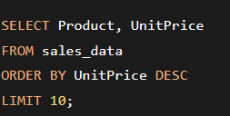
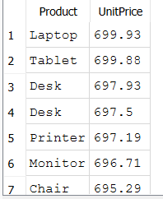
Query 2 – Most Expensive Products
Explanation:
ORDER BY UnitPrice DESC sorts highest to lowest.
LIMIT 10 shows top 10.
Purpose:
Identify high-priced products that may drive revenue despite lower frequency.

Slide 7
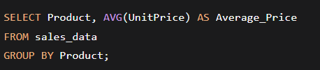
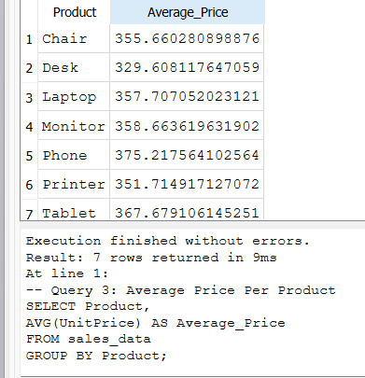
Query 3 – Average Price Per Product
Explanation:
01
AVG(UnitPrice) calculates average price.
GROUP BY Product groups records per product.
Insight:
02
Electronics → higher average prices than furniture/office items.

Slide 8
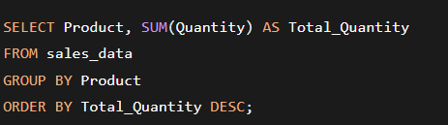
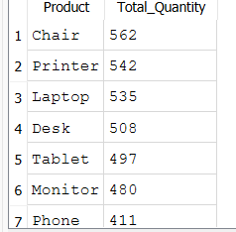
Query 4 – Total Quantity Sold Per Product
Purpose:
Identify products with highest sales volume → customer demand analysis.

Slide 9
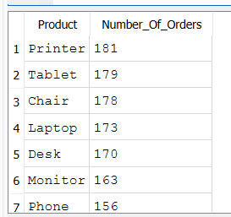
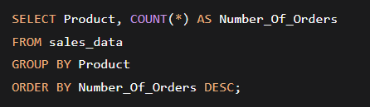
Query 5 – Number of Orders Per Product
Purpose:Find most frequently ordered products → prioritize inventory.

Slide 10

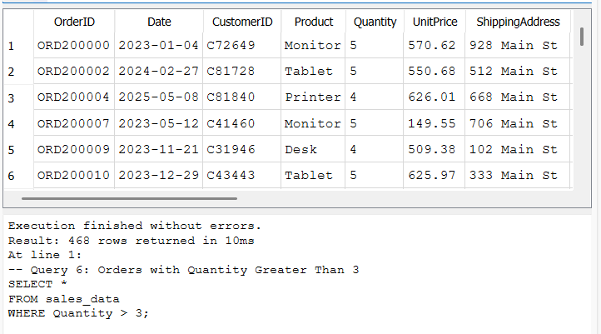
Query 6 – Orders with Quantity > 3
Explanation:
Insight:
WHERE Quantity > 3 filters bulk purchases.
High-quantity orders → possible business/wholesale customers.

Slide 11

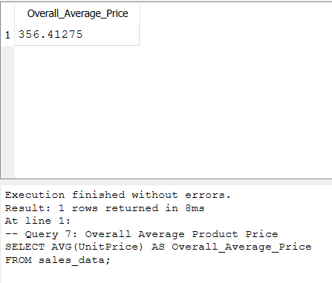
Query 7 – Overall Average Product Price
Purpose:
Overview of company’s pricing strategy (premium vs. budget).

Slide 12
High-priced products contribute significantly to revenue. Some products show high sales volume → strong demand. Bulk orders (quantity > 3) indicate wholesale or business customers. Electronics priced higher than furniture and office items. Most frequently ordered products should be inventory priorities.
Business Insights Summary

Slide 13
Based on SQL analysis, the company should: Focus marketing on top-selling products. Monitor expensive products with lower demand. Improve inventory planning using quantity trends. Use customer purchasing patterns for future decisions. Consider bulk discounts for wholesale buyers.
Business Recommendations

Slide 14




Conclusion
Data-driven decisions supported by filtering, grouping, aggregation.
Queries transformed raw sales data into actionable insights.
SQL is essential for data analysis and business intelligence.
Improved practical SQL and analytical skills.

Slide 15
Thank You
Thank you for your attention!

